Slide 1
McKibben Snake Robots: Mid-Project Progress
Jennifer Yang

Slide 2
Goal
Refine a soft snake robot that can:
Perform sidewinding motion.
Provide data for later validation of simulation models.

Slide 3
Progress
MATLAB Onboarding course completed.
Flow control method implemented and tested.
New airline implemented and tested.

Slide 4
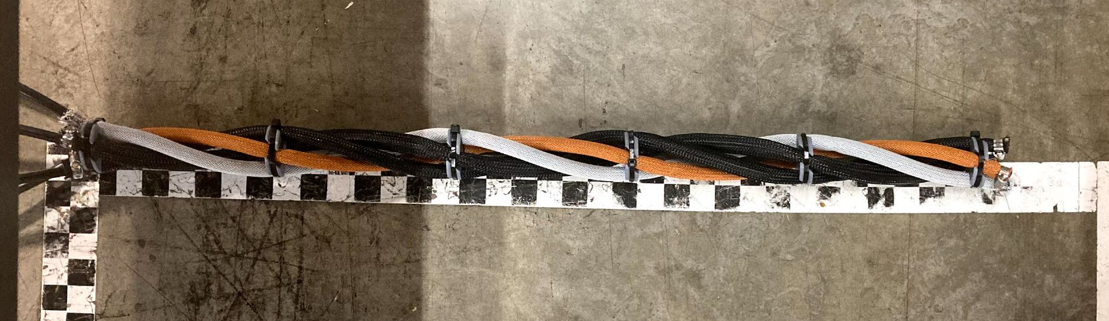
Snake Setup
4 McKibben actuators helically arranged.
3D printed spacers set 6” apart.
Each spacer results in an 180° rotation of the actuators.

Slide 5
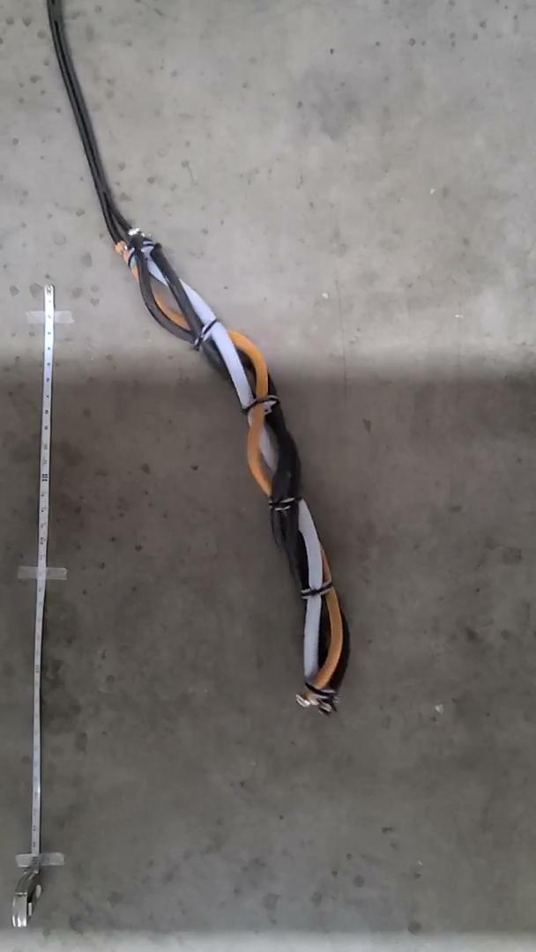
Testing Setup
Tested multiple flow rates to evaluate movement.
Tested with stiff and flexible airlines.
Concurrently inflated and deflated individual tubes on a fixed time cycle.
Flexible unrestricted airlines
Notes:
Video: New airline unrestricted

Slide 6
Airline Comparison
Stiff Airline
1 foot long
Semi-restricted flow moved the furthest on set time cycles

Slide 7
Airline Comparison
Stiff Airline
1 foot long
Semi-restricted flow moved the furthest on set time cycles
Flexible Airline
5 feet long
Unrestricted flow moved the furthest on set time cycles

Slide 8
Airline Results Image Guide
Each image is labeled with what stage of the cycle the robot is at.

Slide 9
Airline Results Image Guide
Each image is labeled with what stage of the cycle the robot is at.
The initial robot position.

Slide 10
Airline Results Image Guide
Each image is labeled with what stage of the cycle the robot is at.
The initial robot position.
The robot position once the concurrent cycles is complete but the robot has not deflated.

Slide 11
Airline Results Image Guide
Each image is labeled with what stage of the cycle the robot is at.
The initial robot position.
The robot position once the concurrent cycles is complete but the robot has not deflated.
The robot position at the end of the concurrent cycles with deflation.

Slide 12
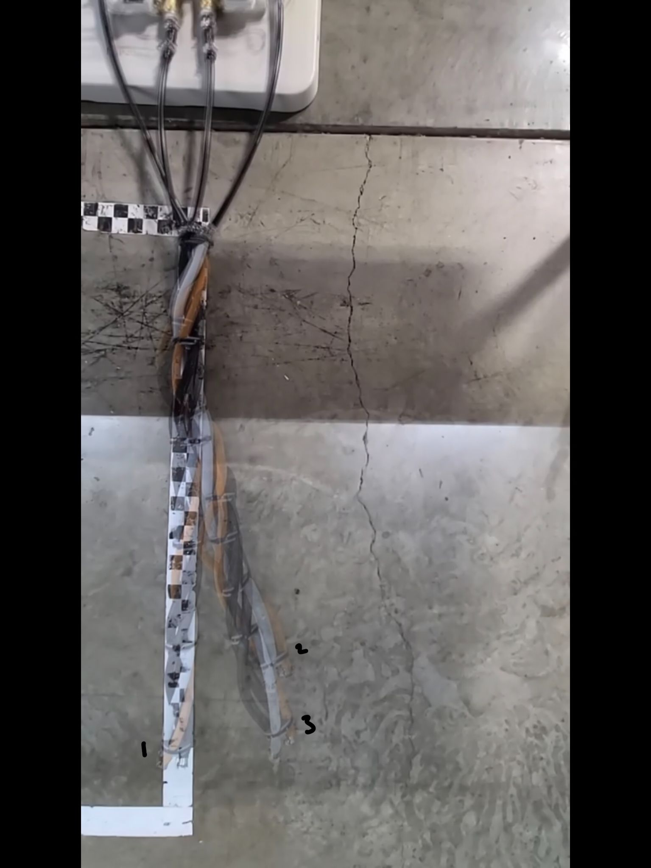
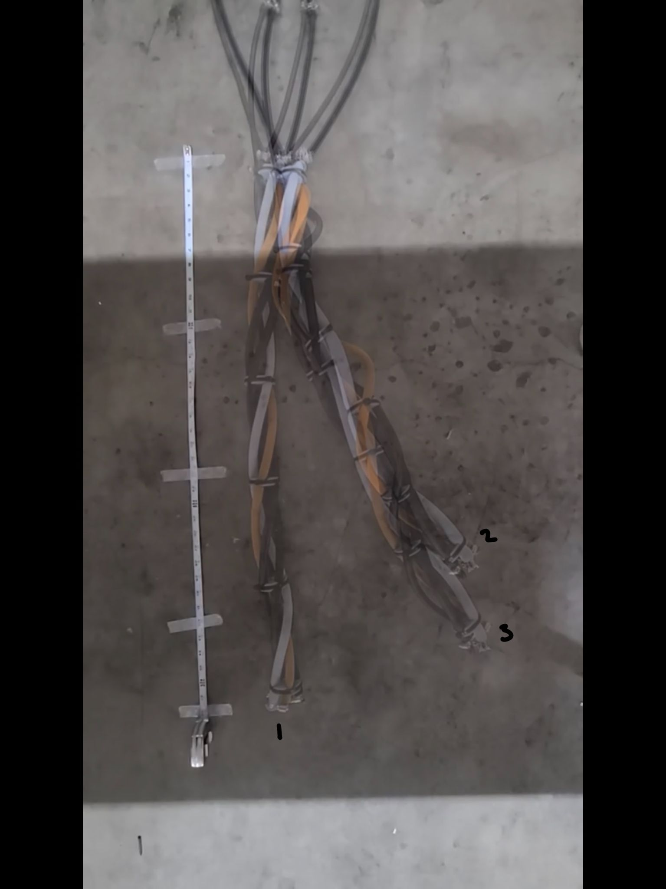
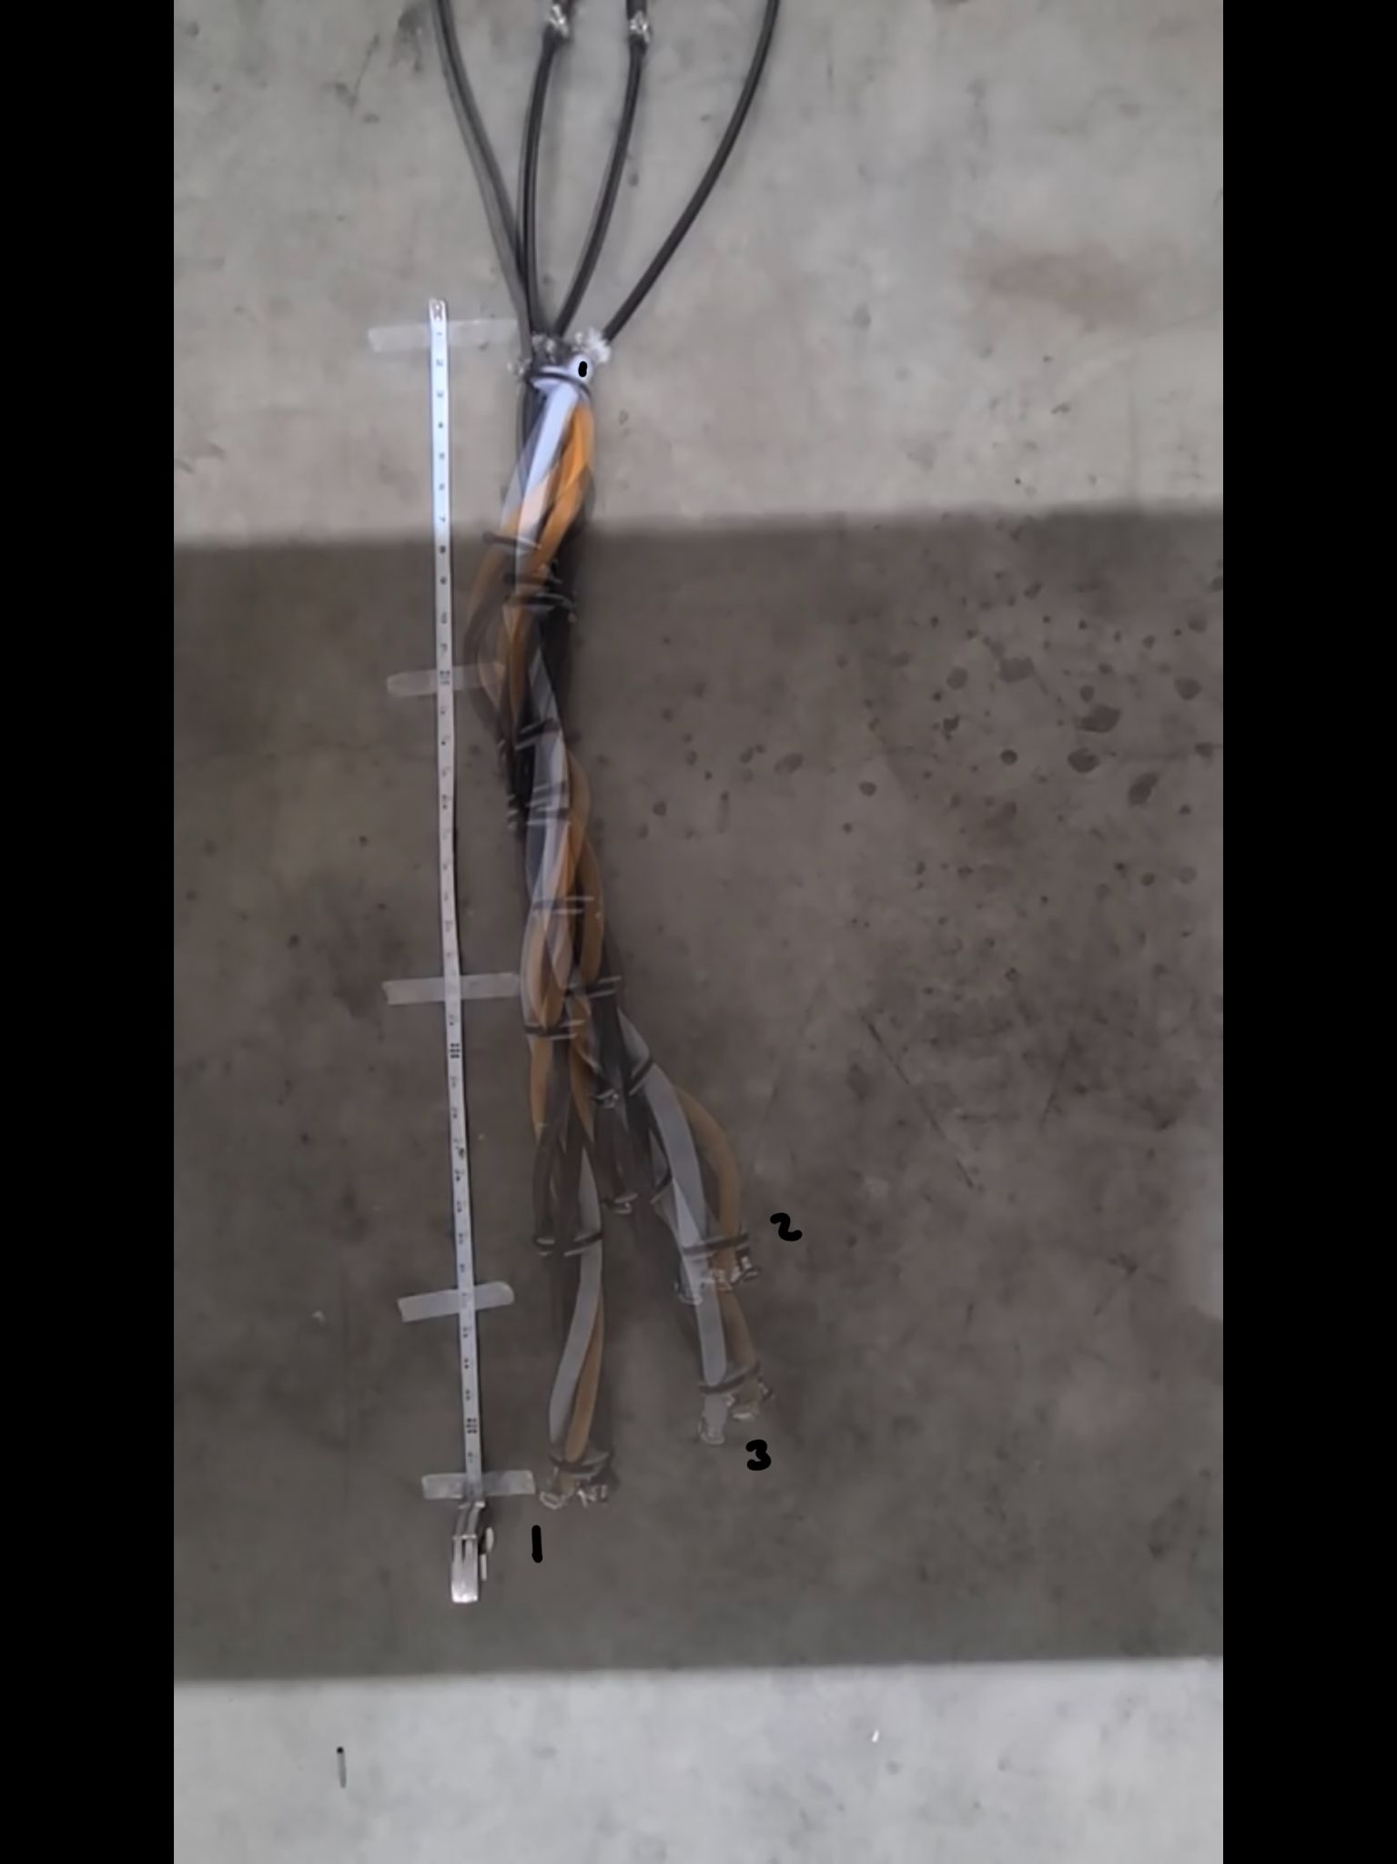
Stiff Airline Testing Results Comparison
No Restriction (0.250”)
0.125” Restrictor
0.050” Restrictor

Slide 13
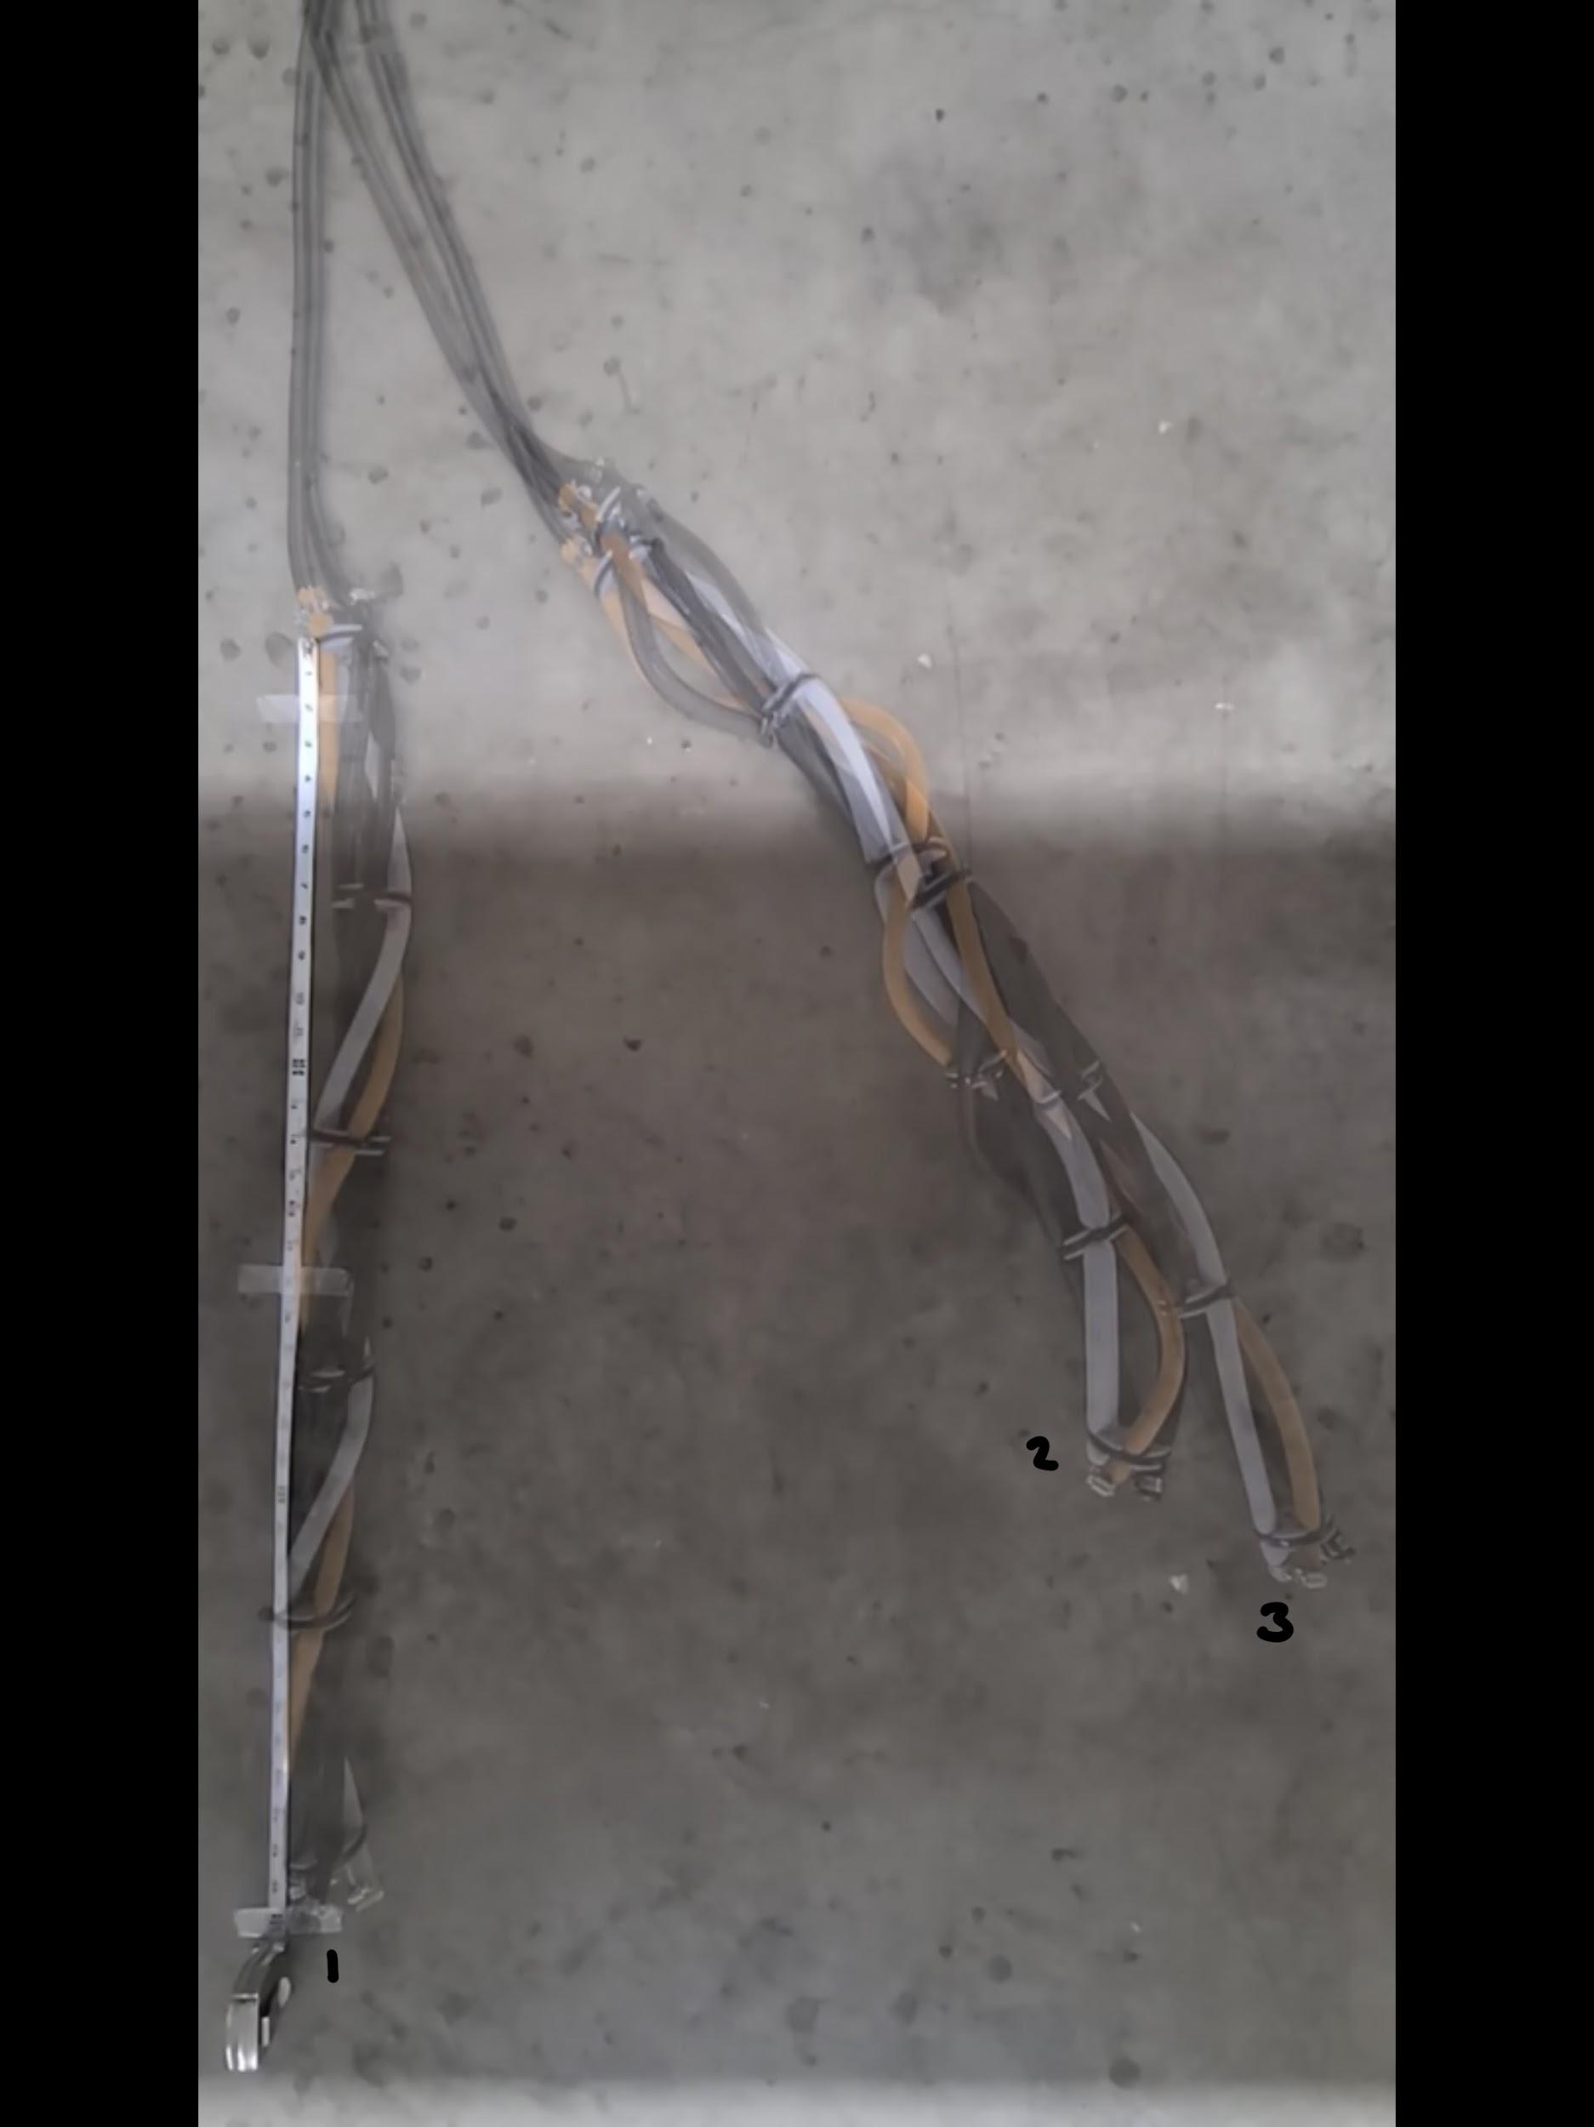
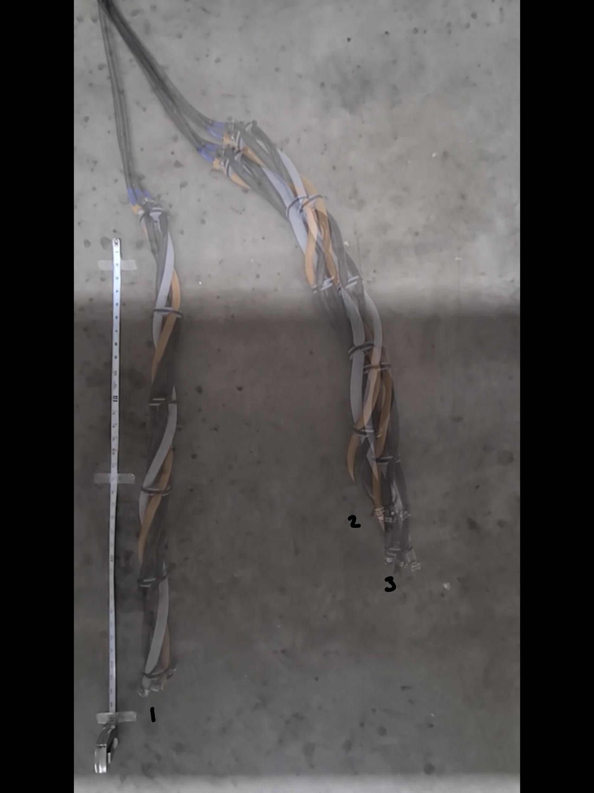
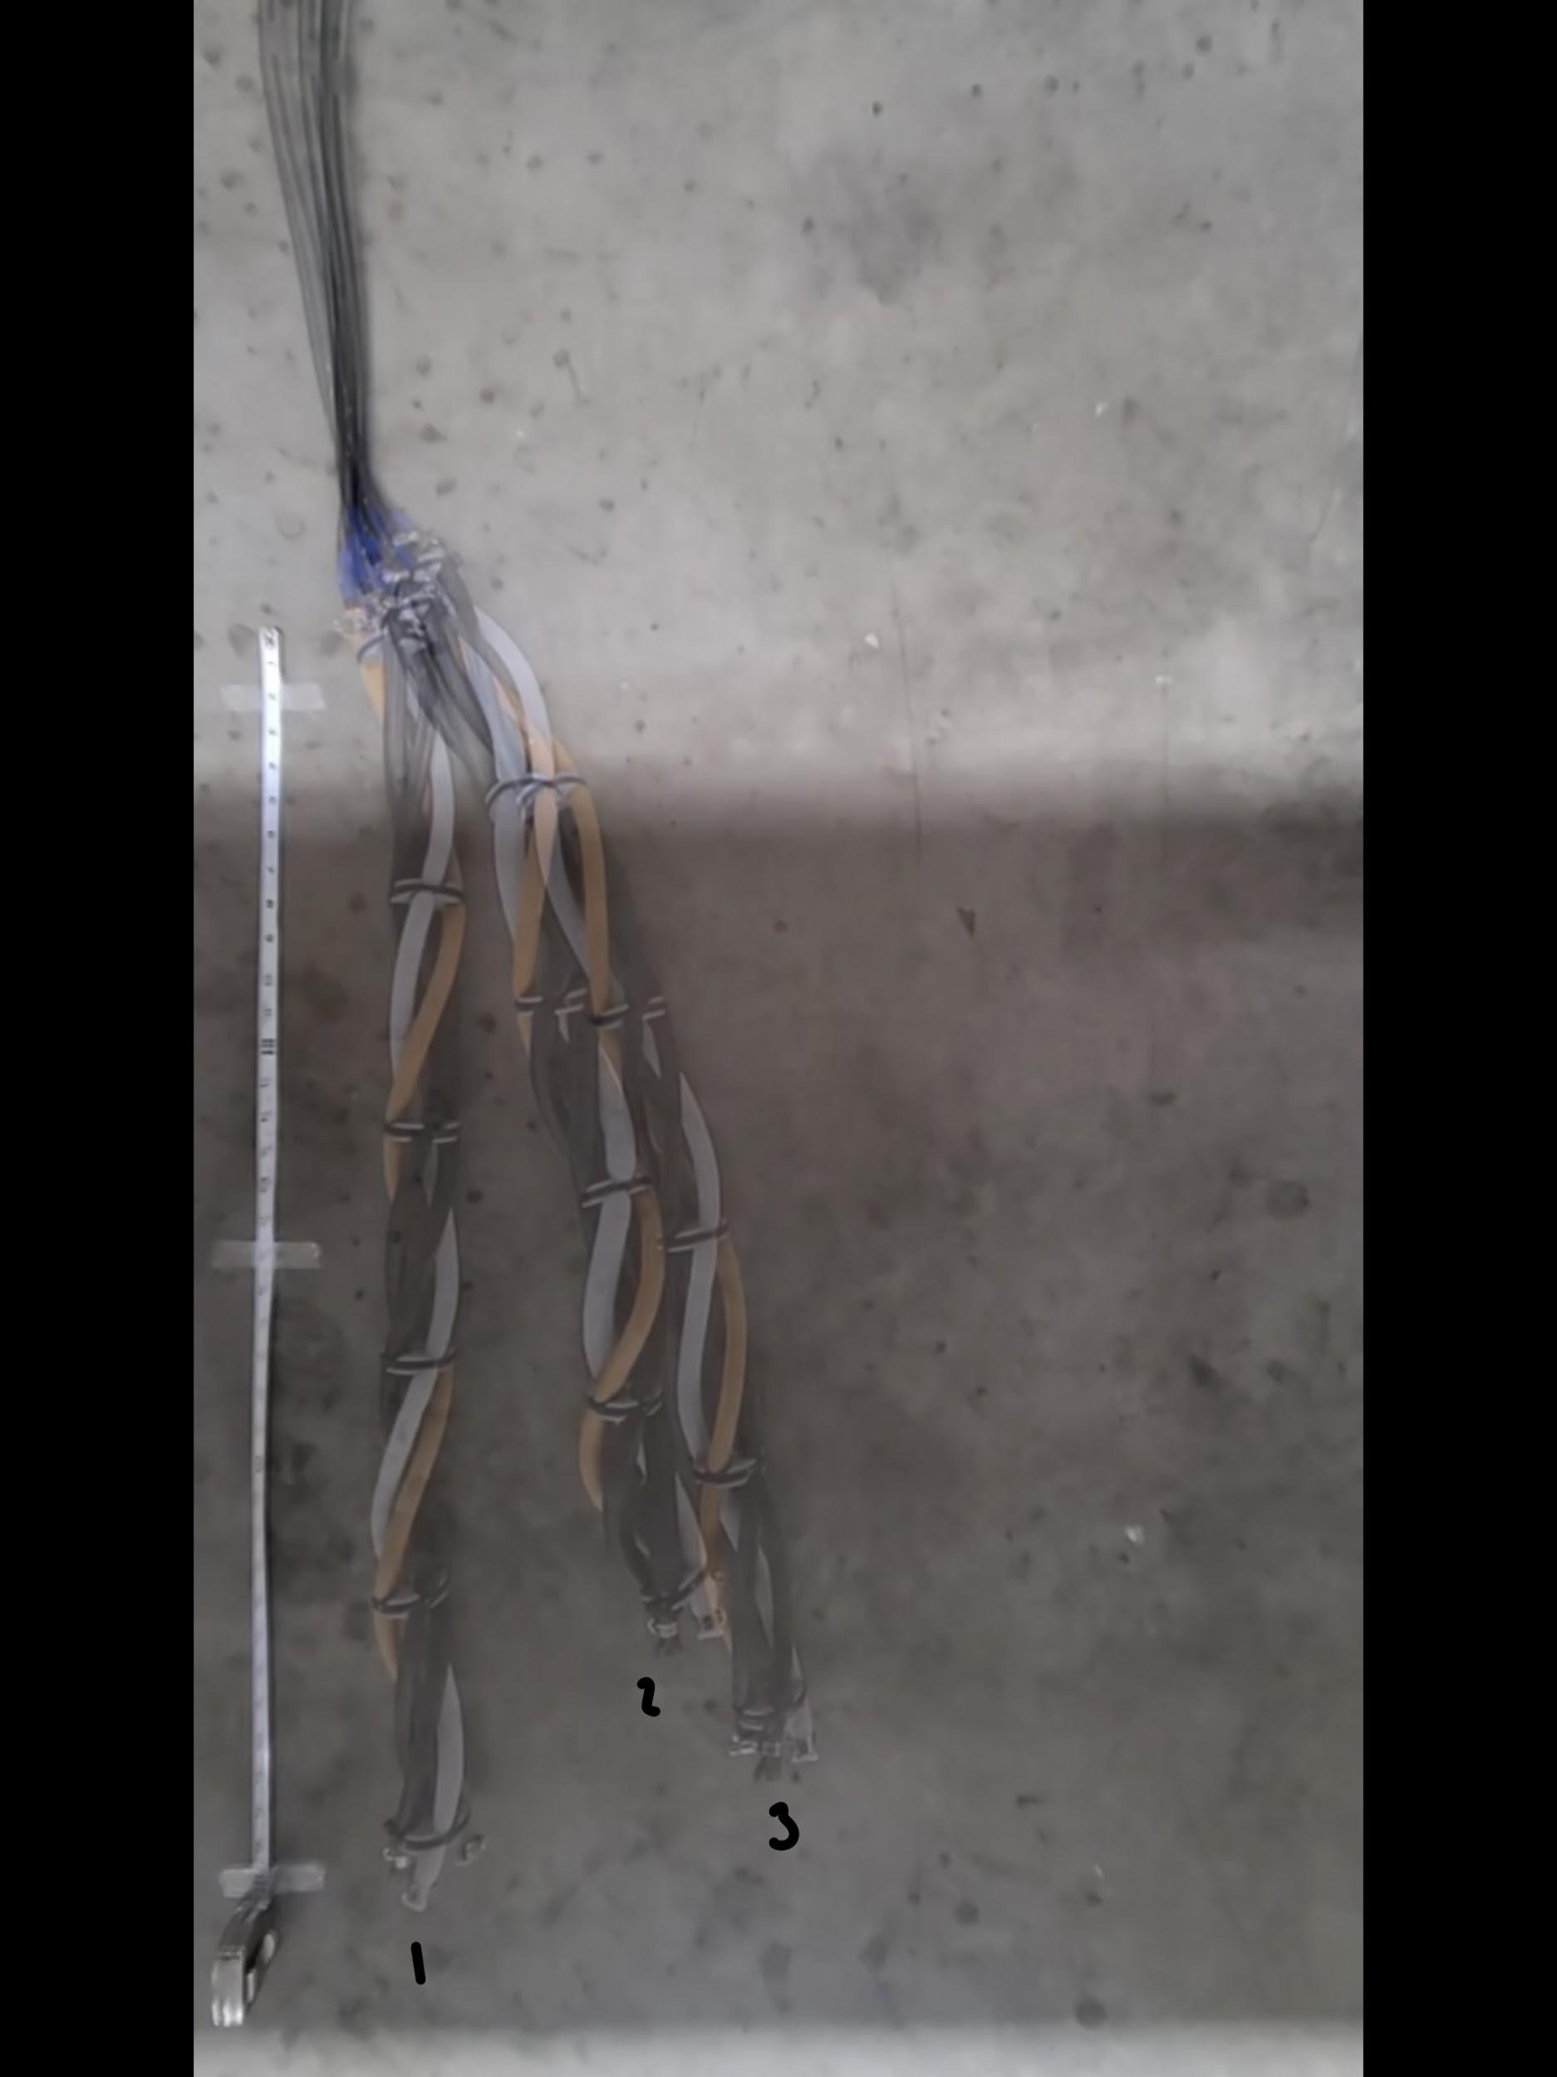
Flexible Airline Testing Results Comparison
No Restriction (0.250”)
0.125” Restrictor
0.050” Restrictor

Slide 14
Stiff and Flexible Best Results Comparison
0.125” Restrictor - Stiff Airline
No Restriction (0.250”) - Flexible Airline

Slide 15
Challenges
Do not have a metric for the best motion yet.
More testing to come with inflation times adjusted according to the flow rate.

Slide 16
Next Steps
Decide on a metric for the best motion.
Test alternative control schemes.
Test snake with different material properties.
Test snake on different terrains and slopes.

Slide 17
Questions?

Slide 18
Flow Rate Calculations
Time = Average time to actuate a single muscle
Volumetric Flow Rate = Volume / Time
Single muscle volume: 4.417 in³
Pressure Flow Rate = Pressure Change / Time
Single muscle pressure change: 60 psi
Notes:
Backup Slide

Slide 19
Flow Rate Estimates
Inner Diameter (in) | 0.250 | 0.200 | 0.150 | 0.125 | 0.100 | 0.075 | 0.050 | 0.025
Inflation Time (s) | 0.545 | 0.556 | 0.656 | 0.633 | 0.689 | 0.756 | 1.289 | 13.54
Volumetric Flow Rate (in³/s) | 8.106 | 7.952 | 6.739 | 6.976 | 6.413 | 5.847 | 3.428 | 0.326
Pressure Flow Rate (PSI/s) | 110 | 108 | 91.5 | 94.7 | 87.1 | 79.4 | 46.6 | 4.43
Notes:
Backup Slide

Slide 20

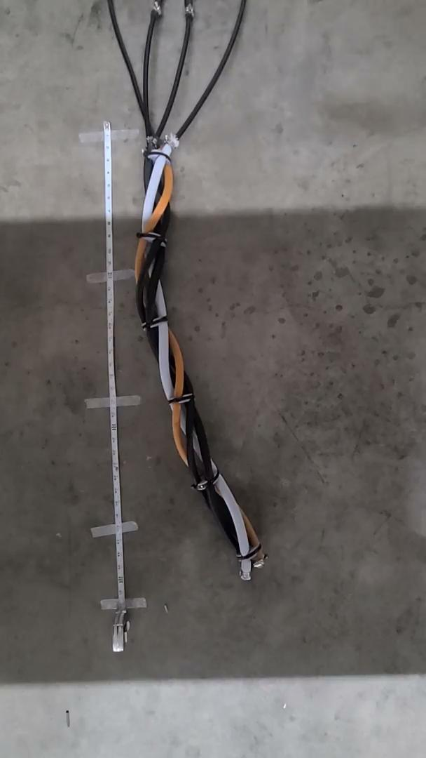
Old Airline Videos
No Restriction (0.25”)
0.125” Restrictor
0.05” Restrictor
Notes:
Backup Slide

Slide 21
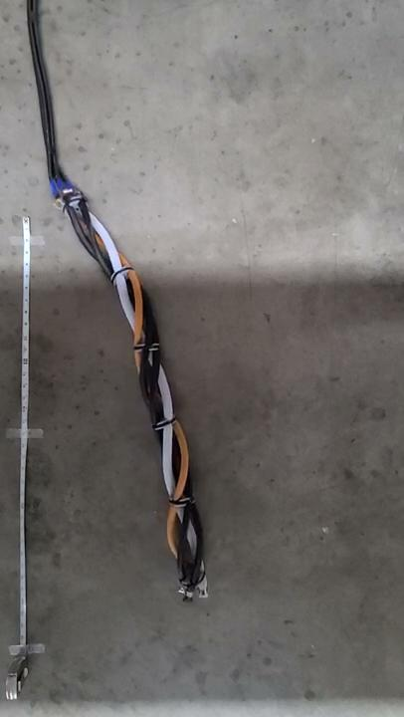
New Airline Videos
No Restriction (0.25”)
0.125” Restrictor
0.05” Restrictor
Notes:
Backup Slide

